Slide 1
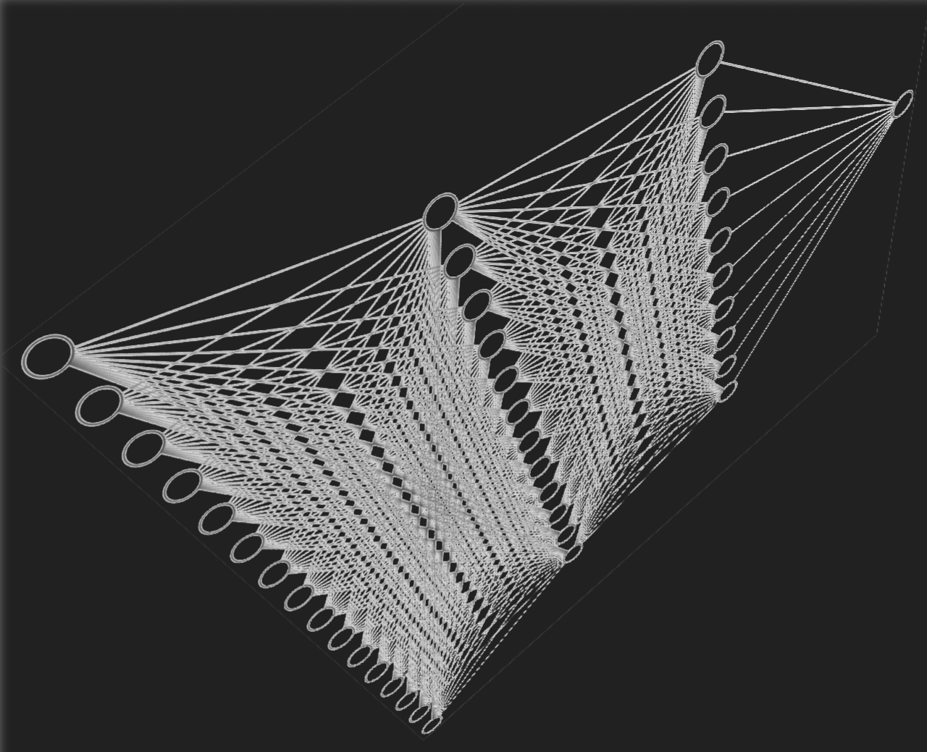
Foundational discoveries and inventions that enable machine learning with artificial neural networks
BIOENG-310 : Neuroscience foundations for engineers
By :
Eddy Rashed
Justin Favey
April 28th, 2025
Source : https://upload.wikimedia.org/wikipedia/commons/0/02/Neural_network_with_dark_background.png

Slide 2
Presentation Plan
Who are the Physics Nobel Prize winners ?
What are the experiences and discoveries they accomplished ?
What were their results ?
How is it important for neuroscience ?

Slide 3
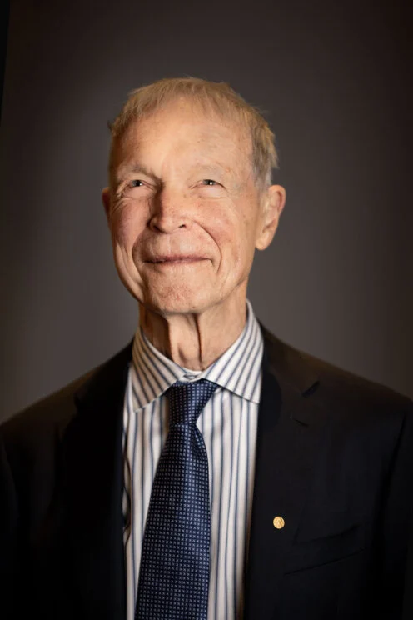
John Hopfield
Born in 1933 in Chicago, he is an American theoretical physicist specialized in biological physics.
He is mostly known for his studies on electron transfers in biomolecules, as well as error correction in biochemical reactions to explain precision in DNA replication.
In 1982, he writes his 1st article in neuroscience, named «Neural networks and physical systems with emergent collective computational abilities».
This article is now considered a cornerstone of computational model in neuroscience, and earned him the Nobel Prize of Physics in 2024.
Source : https://www.nobelprize.org/images/165779-portrait-medium.jpg

Slide 4
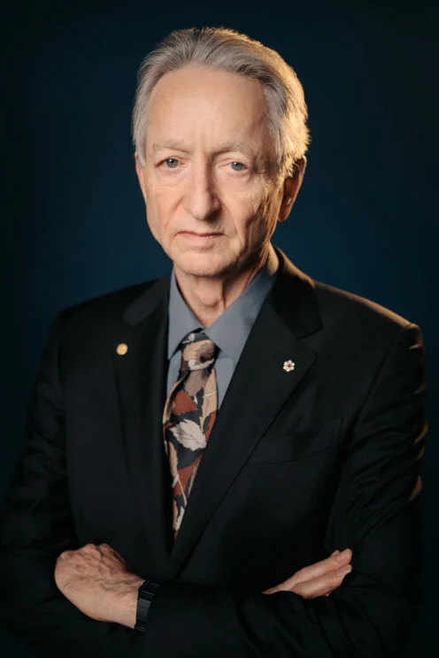
Goeffrey Hinton
Born in 1947 in the UK, he is a researcher specialized in artificial intelligence, cognitive psychology and artificial neuron networks.
He is greatly recognized for the progress he brought to deep-learning technologies and popularizing back-propagation in multilayered neuronal networks, notably by pushing further the concepts discovered by Hopfield.
His breakthrough of image recognition with the AlexNet model was deemed as a revolution the field of computer vision.
He was co-awarded the 2024 Physics Nobel Prize alongside Hopfield.

Slide 5
Experiences & Discoveries
"Computers were initially intended to carry out computations that were cumbersome and time-consuming for humans. In the 1950s, the opposite need emerged, namely to get computers to do what humans and other mammals are good at – pattern recognition"
Nobel Commitee of Physics, 2024
Notes:
Hopfield asked whether emergent
collective phenomena in large collections of neurons could give rise to “computational” abilities

Slide 6
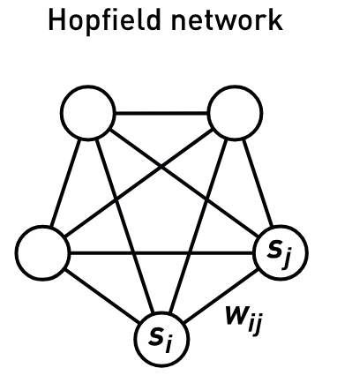
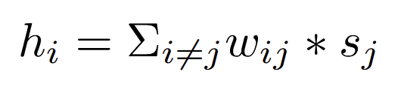

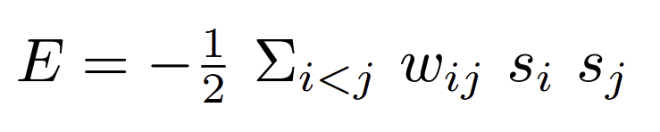
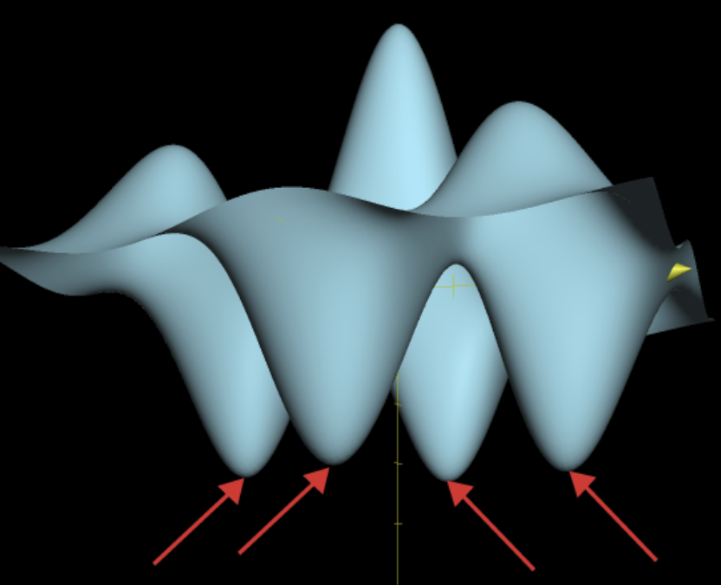

Hopfield Network
Eddy Rashed, Justin Favey
Also known as associative memory networks, RNN use Hebbian learning (neurons that fire together, wire together) to encode memories.
Goal : recreate/recover known patterns based on a form of neuronal memory.
Hopfield network : non-directed graph, each neuron has a binary state, connected to every other neuron through weighted edges. The value of each neuron is modified as such :
Taken from spin glass systems in physics, Hopfield networks are built on the reduction of energy concept to find its optimal resting place
Training is done as such :
Combine memories for different states by adding their local minimas separately to the same function to recreate different "memories" from a single neural network.
Source : https://cdn.kastatic.org/ka-perseus-images/8b84c57a01a932d4ab900e48cd4880128998fffd.png

Slide 7
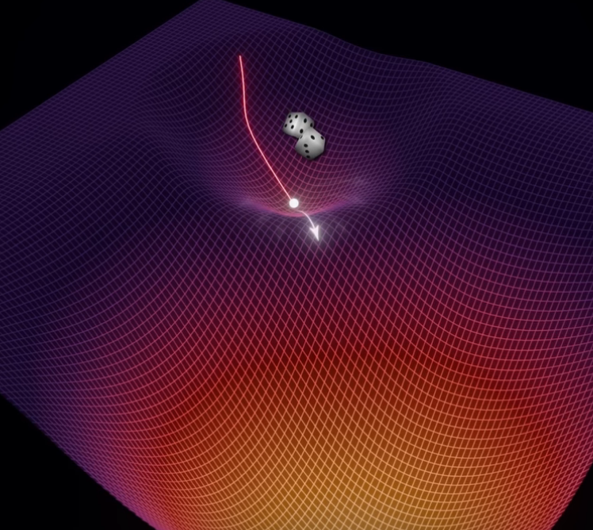
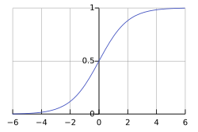
Boltzmann machines
Stochastic update with Sigmoid function, randomness depends on the temperature hyperparameter
Artem Kirsanov. (2024, August 13). Generative model that won 2024 Nobel Prize [Video]. YouTube. https://www.youtube.com/watch?v=_bqa_I5hNAo
Notes:
Update to the hopfield network in 1983-1985
The update rule is now stochastic. Hij which was directly chose if wij > or < 0 is now put into the sigmoid function to obtain a probability. We then generate a random number between 0 and 1 and if > prob set hij to 1 else 0. This allows to escape local min.
The model now depends on a new hyperparameter called temperature, which determines how random our neural network is. At high temperatures the sigmoid function resembles a line whereas with low temperatures it ressembles a step function; what is used for the Hopfield network

Slide 8
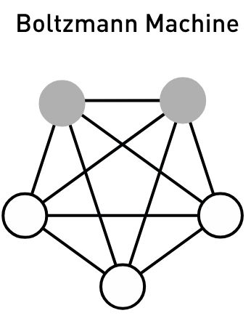
Boltzmann machines
Learns weights from the data : unsupervised learning
Learns by contrastive Hebbian learning, alternates between :
  positive phase with input data from which to learn
  negative phase with random data from which not to learn
Notes:
Learning is done by modifying the weight positively if the connection between I and j occurs in the training data (positive phase), and decreasing it if the connection between I and j happens in a random state (neg. Phase) - Contrastive Hebbian learning
Also have hidden units which do not serve as output but as internal representations of latent variables
In positive phase visible units are clamped to data and hidden units can vary and update as per the update rule
Negative happens normally

Slide 9
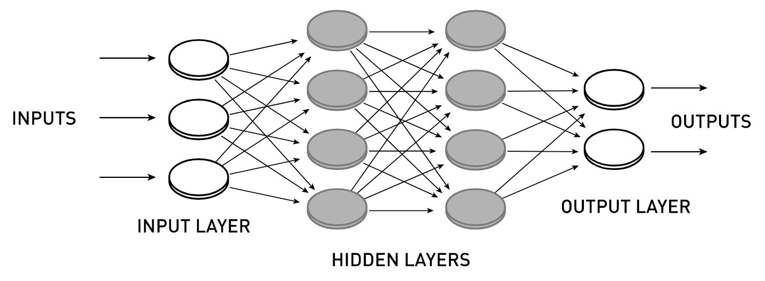
Feed-Forward Neural Networks, CNNs and others
Hinton et al. popularized the famous backpropagation algorithm with their 1986 paper
Showed that a hidden layer permits non-linearity
Set the foundations for Yann Le Cun's Convolutional Neural Network among many others
Still a problem to train deep neural networks in the 90's
Notes:
In the 1986 paper he coauthored, Hinton formalized the backpropagation algorithm used to train most supervised neural networks of today
Furthermore, they showed that networks with a hidden layer, and thus non-linearity, could perform tasks that could not be solved by networks without such a layer
This foundation was used for research on models such as the Convolutional Neural Network by Yann Le Cun and others
The problem of training deep multilayered networks remained in the 90's

Slide 10
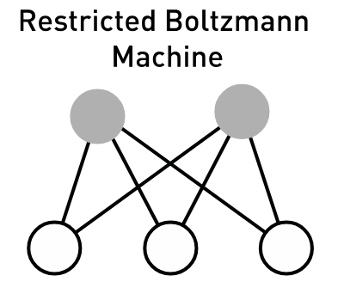
Restricted Bolzmann Machines
Removes all links between neurons of the same types (hidden-hidden and visible-visible)
Allows for parallel neuron updates with the contrastive divergence algorithm
With RBMs, training deep neural network was now possible by "pre-training" each layer with an RBM which allows for finding structure in data, and can then be fine-tuned by back-propagation
Notes:
When the New York Times reporter Cade Metz asked Hinton to explain in simpler terms how the Boltzmann machine could "pretrain" backpropagation networks, Hinton quipped that Richard Feynman reportedly said: "Listen, buddy, if I could explain it in a couple of minutes, it wouldn't be worth the Nobel Prize.
Stopped the AI winter of the early 2000's by allowing training of deep neural networks, even if the technology did quickly get replaced by something better quickly

Slide 11
Research Implications...
Allowed for new hypotheses on how the brain functions and remembers informations (multiple simpler systems working together, or a great complex system ?), realizing that synapses play a key role in memory.
Abled to recreate primitive functions of the brain using known, simpler systems observed in the brain (firing rate, action potential, etc..).
Created modern supervised and unsupervised machine learning models, which lead way for efficient image recreation and de-noising.
Simulated "creativity" and unpredicteness in machine learning using hidden layers.
Artificial Neuron Networks (ANN) are now used for common and complex tasks in scientific fields such as image recognition, anomaly detection, language detection, and many more !
BIOENG-310 : Neuroscience foundations for engineers

Slide 12
Sources
"For foundational discoveries and inventions that enable machine learning with artificial neural network", Nobel Commitee of Physics, 2024
https://en.wikipedia.org/wiki/Spin_glass
https://en.wikipedia.org/wiki/Feedforward_neural_network
https://en.wikipedia.org/wiki/Hopfield_network
https://www.nobelprize.org/prizes/physics/2024/hinton/facts/
https://fr.wikipedia.org/wiki/Geoffrey_Hinton
https://fr.wikipedia.org/wiki/John_Joseph_Hopfield
Hopfield, J. J. (1982). Neural networks and physical systems with emergent collective computational abilities. Proceedings of the national academy of sciences, 79(8), 2554-2558
Generative model that won 2024 Nobel prize, Artem Kirsanov (2024), https://www.youtube.com/watch?v=_bqa_I5hNAo
A brain-inspired algorithm for Memory, Artem Kirsanov (2024), https://www.youtube.com/watch?v=1WPJdAW-sFo

